Slide 1
In the name of god
Create by:
yeganeh shahi pour
And
Setayesh hatami

Slide 2
Lesson 6 My House

Slide 3
movie
bedroom
w.c(water close)
bath
Living room
stairs
kitchen
door

Slide 4
Please listen to conversation

Slide 5
Please listen to practice 1

Slide 6
Please listen to practice 2

Slide 7
Please listen to sound

Slide 8
Please listen to conversation
1
2

Slide 9
dictionary
:Bed room
Living room :

Slide 10
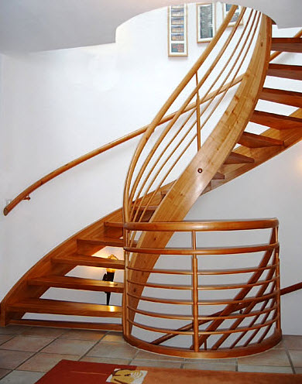
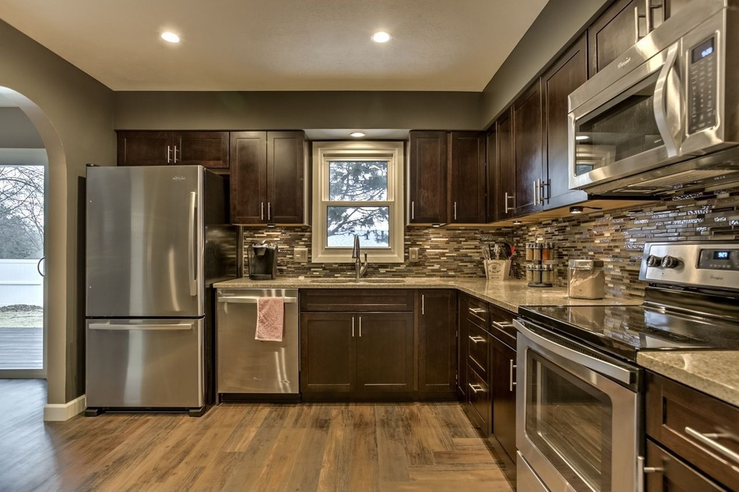
Stairs :
Kitchen :

Slide 11
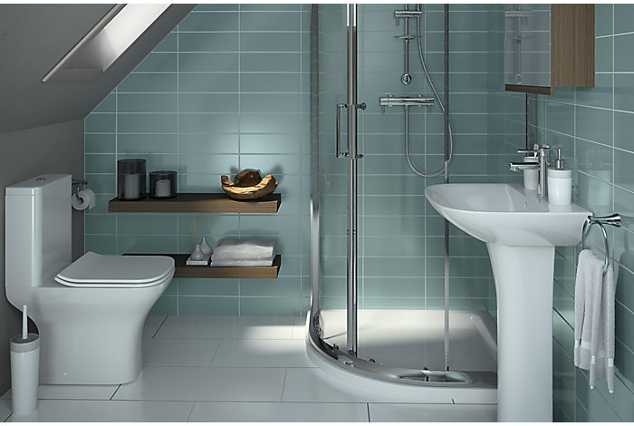
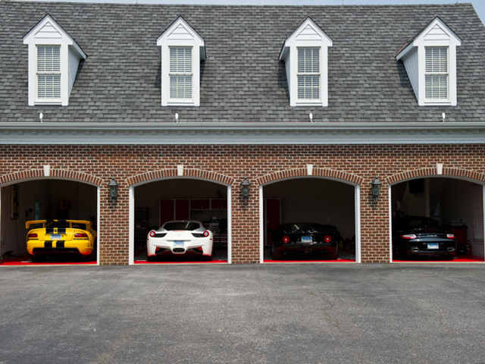
Bathroom :
Garage :

Slide 12
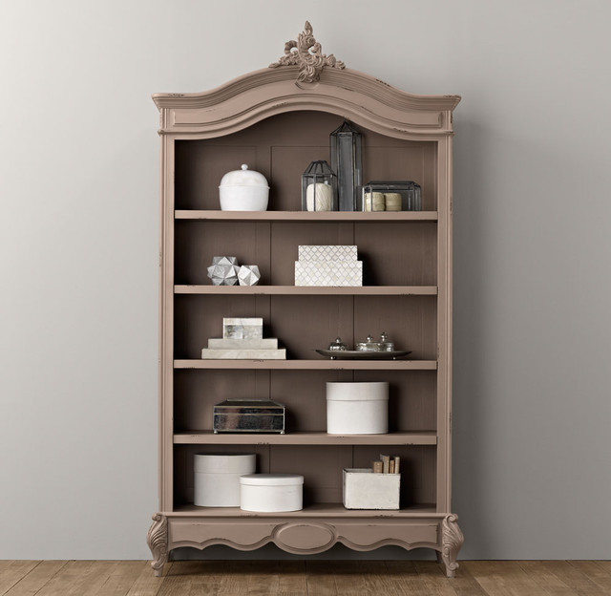
Bookcase :
Blanket :

Slide 13
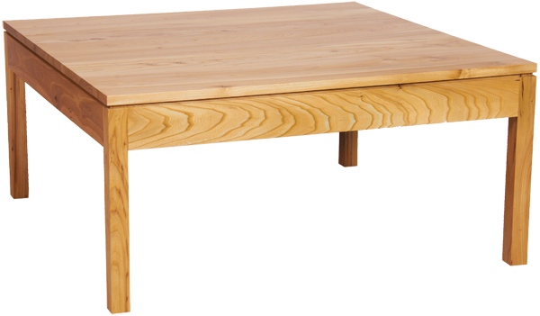
Clock :
Tabel :

Slide 14
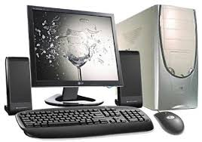
Computer :
Television :

Slide 15
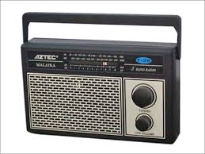
Mirror :
Radio :

Slide 16
Comb :
Newspaper :

Slide 17
Cooking :
Playing :

Slide 18
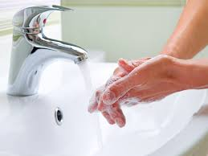
Washing :
Fixing :

Slide 19
Watching :
Working :

Slide 20
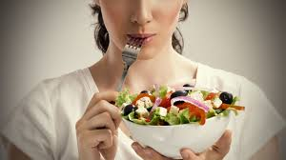
Reading :
Eating :

Slide 21
Studying :
Drinking :

Slide 22
end

